Slide 1
IT694 Computer Networks
IP Addressing

Slide 2

IP addressing: introduction
223.1.1.1
IP address: 32-bit identifier associated with each host or router interface
interface: connection between host/router and physical link
router’s typically have multiple interfaces
host typically has one or two interfaces (e.g., wired Ethernet, wireless 802.11)
223.1.2.1
223.1.1.2
223.1.1.4
223.1.2.9
223.1.1.3
223.1.3.27
223.1.2.2
223.1.3.1
223.1.3.2
dotted-decimal IP address notation:
223.1.1.1 = 11011111 00000001 00000001 00000001
223
1
1
1

Slide 3
IP addresses: how to get one?
That’s actually two questions:
Q: How does a host get IP address within its network (host part of address)?
Q: How does a network get IP address for itself (network part of address)
How does host get IP address?
hard-coded by sysadmin in config file (e.g., /etc/rc.config in UNIX)
DHCP: Dynamic Host Configuration Protocol: dynamically get address from as server
“plug-and-play”

Slide 4
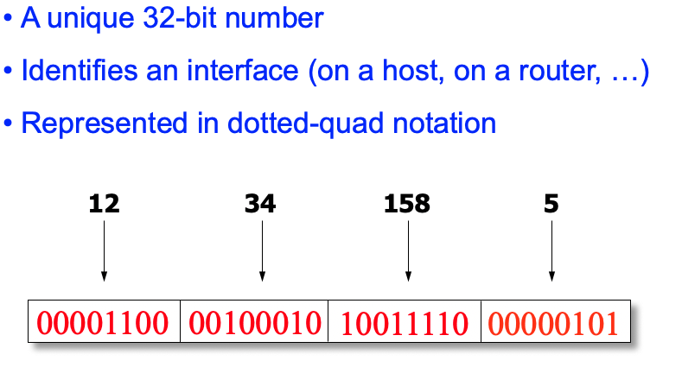

Slide 5
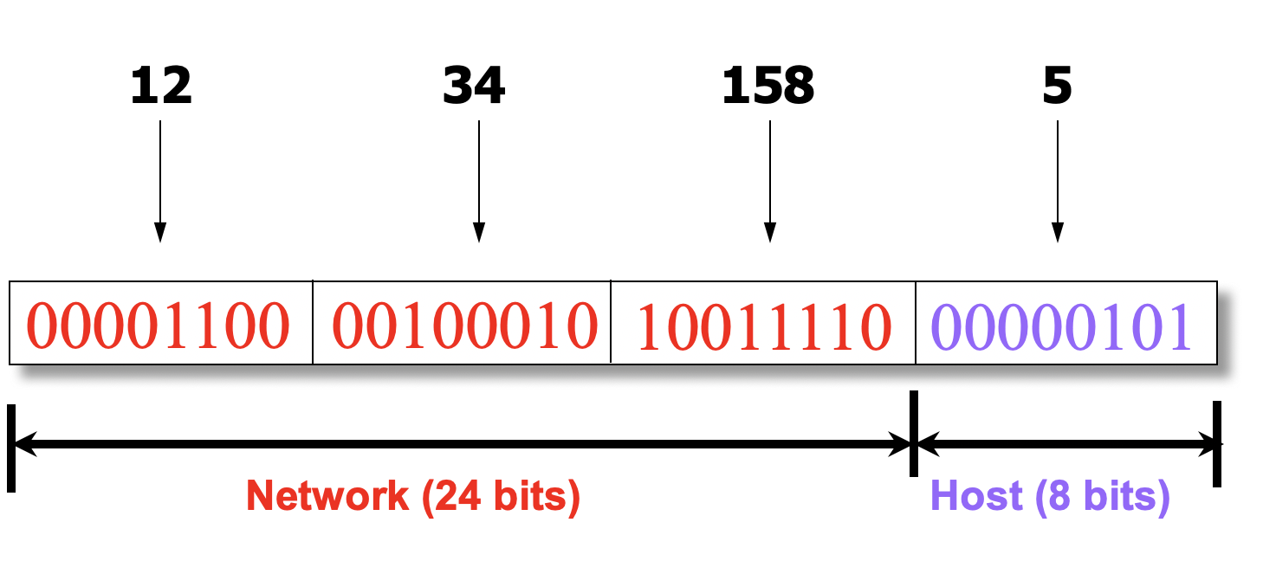
Hierarchical Addressing
Addressing in the Indian mail sys
Zip code: 382007
Street: Indroda circle
Building on street: DAIICT
Room in building: 21**
Name of occupant: ABC
Forwarding the mail
Deliver letter to the post office in the zip code
Assign letter to mailman covering the street
Drop letter into mailbox for the building/room
Give letter to the appropriate person
Divided into network & host portions (left and right)
12.34.158.0/24 is a 24-bit prefix with 2⁸ addresses

Slide 6
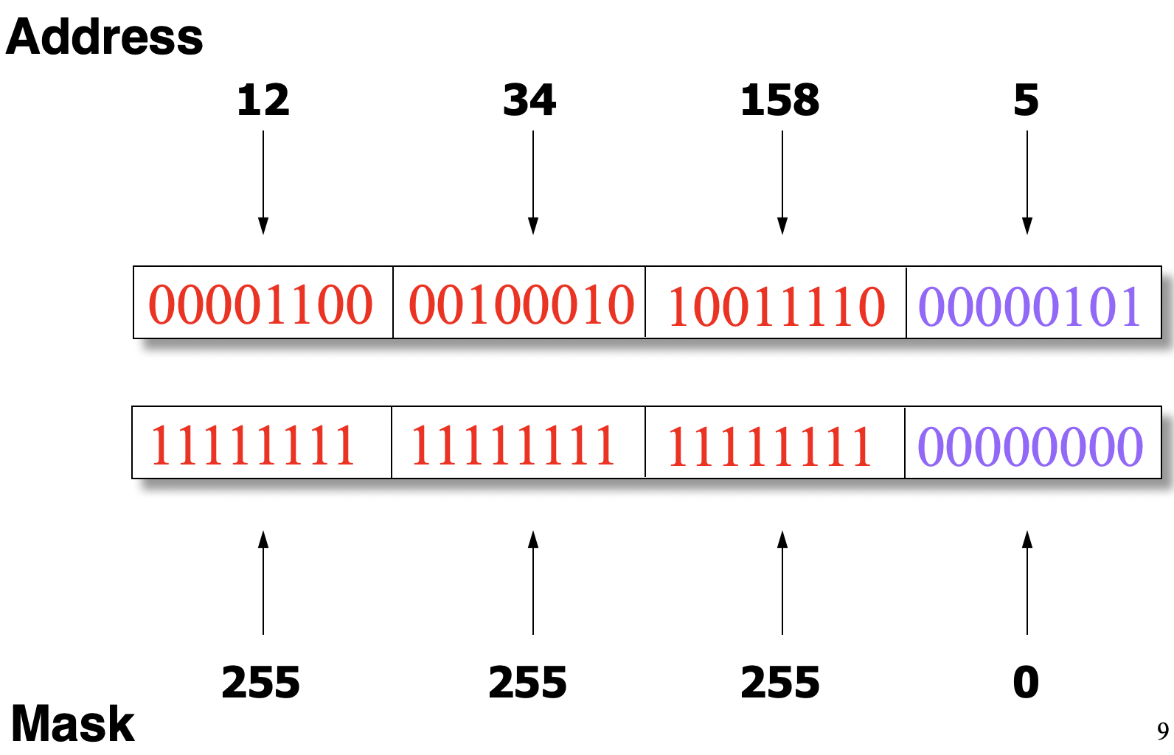
IP Address and a 24-bit Subnet Mask

Slide 7
Classful Addressing
In the olden days, only fixed allocation sizes
Class A: 0*
Very large /8 blocks
Class B: 10*
Large /16 blocks
Class C: 110*
Small /24 blocks
Class D: 1110*
Multicast groups
Class E: 11110*
Reserved for future use

Slide 8
Subnets
223.1.1.1
What’s a subnet ?
device interfaces that can physically reach each other without passing through an intervening router
detach each interface from its host or router, creating “islands” of isolated network
each isolated network is called a subnet
223.1.2.1
223.1.1.2
223.1.1.4
223.1.2.9
223.1.1.3
223.1.3.27
223.1.2.2
IP addresses have structure:
subnet part: devices in same subnet have common high order bits
host part: remaining low order bits
223.1.3.1
223.1.3.2
network consisting of 3 subnets

